Slide 1
XP262 |
Best practices for a successful clean core journey with
SAP Build solutions
Marco Matha
Katrin von Ahsen, Marc Huber, Niklas Siemer
November 2025

Slide 2


Agenda
  Introduction
  Clean Core
  SAP Application Extension Methodology
Exercise 1 – SAP Application Extension Methodology
  Start at 10:40 AM CET
  50 minutes
Exercise 2 – SAP Build Process Automation
  Start at 11:30 AM CET
  30 minutes
Exercise 3 – SAP Build Apps
  Start at 12:00 AM CET
  30 minutes

Slide 3
Clean Core

Slide 4
Clean Core - The five guiding principles
Keep competitiveness while reducing complexity.
1
Business processes
Five clean core principles ensure that business-critical systems remain agile, cost-efficient, and ready to adopt innovations that drive growth.
By adopting standard processes, while incorporating stable extensions and integrations for differentiating processes, the clean core principles help customers flexibly adapt to changing business requirements and adopt new capabilities.
Decouple extensions
from the standard core.
2
Extensibility
Control data according
to the latest standards.
3
Data
Keep the system landscape
reliable and flexible.
4
Integration
Keep the operations
effective and efficient.
Operations
5

Slide 5
Clean core extensibility model
SAP S/4HANA Cloud Private Edition
SAP Business Technology Platform
Clean core
levels
SAP standard objects
On-stack extension
Side-by-side extension
highest
Extend with ABAP Cloud, CAP, or low-code/no-code tools (SAP Build)
[Released] SAP remote API
Extend with ABAP Cloud (SAP Build)
A
[Released] SAP local API
Cloud development and
usage of released APIs*
A
[Released] SAP extension point
Extend with classic
ABAP
B
[Classic] SAP extension point
Usage of best practice
/ classic API**
B
[Classic] SAP API
C
Consumption of internal objects
(conditionally clean when applying changelog for SAP objects)
[Internal] SAP object
C
D
[Not recommended]
SAP object
Not clean core
Not upgrade-stable,
not recommended
D
[Not recommended] SAP extension point / technology
lowest
*available on SAP Business Accelerator Hub
**available in Cloudification Repository Viewer
SAP Build includes AI-enhanced pro-code and low-code tools for on-stack and
side-by-side application development and process automation.

Slide 6
SAP Application Extension Methodology

Slide 7

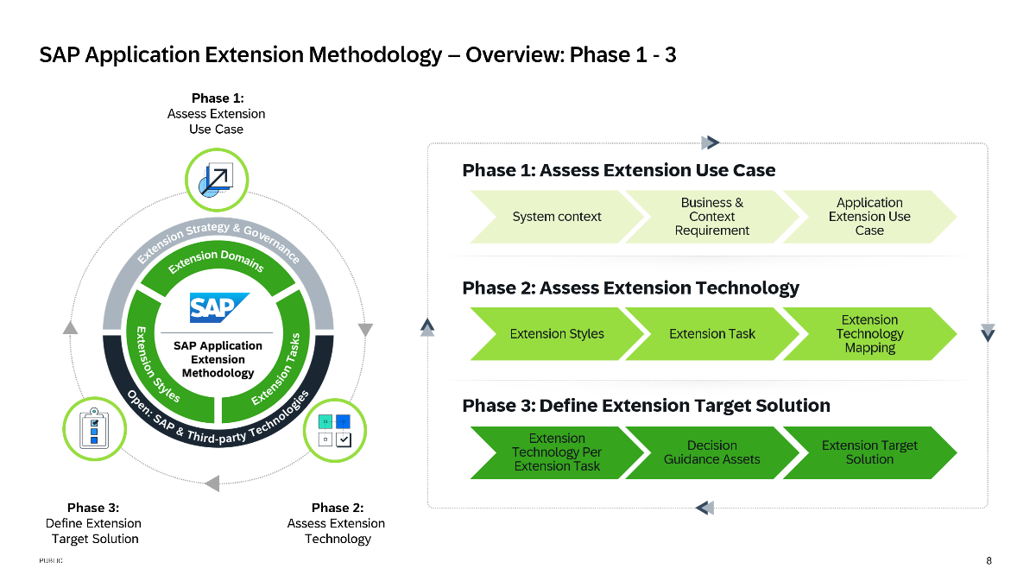
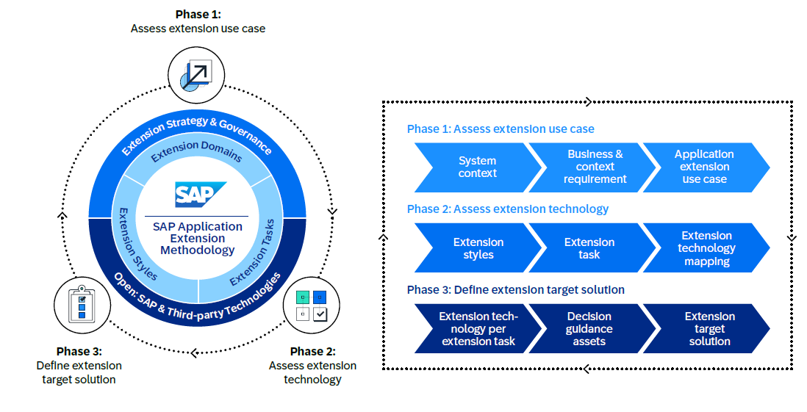
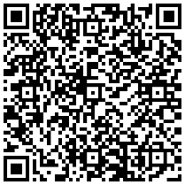
Extension architecture
SAP Application Extension Methodology
2
Extension
architecture
SAP Application Extension
Methodology
To access scan this code
or click the link on top
The SAP Application Extension Methodology helps you to define, document and execute an enterprise extension strategy
for your organization.

Slide 8
2
Extension
architecture
Extension architecture
Visualization of the Decision Guidance per Extension Task (customer specific)
Example
Tier
Architecture
Building
Block
Clean Core
Level
SAP Fiori Elements
A
Presentation Tier
Extension
Domain
SAPUI5
A
On-stack
Classic Extensibility: Dynpro
B
Classic Extensibility: WebDynpro
B
Extension
Style
Extension
Task
New User Interface
Create
custom UI
SAP Fiori Elements
A
Extension
Domain
SAPUI5
A
Side-by-Side
UI5 Webcomponent
A
SAP Mobile Services
A
SAP Build Apps
A
Clean Core Levels
Source of truth for clean core levels: SAP-Note 3578329
lowest
D
B
highest
C
A
Notes:
https://me.sap.com/notes/3578329

Slide 9
👉 Deep Dive Session:
XP100 | Accelerate adoption of SAP Business Technology Platform with confidence
Thursday, Nov 6
1:00 PM – 1:45 PM CET
Katrin von Ahsen
Kay Schmitteckert

Slide 10
Contact information:
Marco Matha
BTP Product Management
Join me online: https://www.linkedin.com/in/marcomatha/

Slide 11
Exercise 1
SAP Application Extension Methodology

Slide 12
Exercise 1.1:
Use case example:
Sales order process extension

Slide 13
Use case example: Sales order process extension
System Context
Business & Context
Requirement
Application Extension
Use Case
Business Case:
The sales department at ACME Corporation has specific requirements for its end-to-end lead-to-cash sales order process - specifically for sales order data entry and the approval workflow. The Cloud ERP will remain the system of record for sales orders. A fit-to-standard workshop concluded these requirements cannot be met with SAP standard applications. Because the custom process offers a competitive advantage, ACME’s leadership approved its development on the condition that it follows the Clean Core strategy.
A custom sales order entry app on SAP BTP validates input and posts orders to the Cloud ERP using standard APIs. The UI displays customer, product, quantity, and delivery date. Product data is retrieved from the Cloud ERP. An internal sales representative enters the order details and triggers the automated approval workflow.
ACME’s sales order entry requires additional validations and approvals. The automated approval workflow is triggered when the quantity exceeds defined thresholds (e.g., >10). All these scenarios require approval from the Sales Manager. The solution must include two forms — "Sales Order Approval" and "Sales Order Rejected" — each displaying product, quantity, customer name, expected delivery date, and a free-text message field for the buyer.
Architecture Principals and Business Context:
Extensions needs to be upgrade stable and follow Clean Core Level A
SAP Build Low-code/No-code tools are preferred for development
Side-by-Side options are preferred for workflow implementation and UIs
ACME employees are used to access SAP application through SAP Build Work Zone
Your Role and Task:
You’re a member of ACME Corporation’s Enterprise Architecture team, tasked with creating a target solution diagram to prepare for the implementation of this extension use case. Having recently learned about the SAP Application Extension Methodology, you plan to apply it to guide the architecture of this project.

Slide 14
Exercise 1.2:
Assess Extension
Use Case

Slide 15
System Context
Business & Context
Requirement
Application Extension
Use Case
I. System Context – Template
Example
List of Solutions | List of Solutions
ID | Solution | Version | SID (host) | Owner | Solution Lifecycle | Deployment | Deployment To-Be
 |  |  |  |  |  | As-is | To-Be
01 | SAP S/4HANA Cloud Public Edition | Latest
02 | SAP Business Technology Platform | Latest

Slide 16

II. Business Context & Requirement – Template
System Context
Business & Context
Requirement
Application Extension
Use Case
Example
Business Context & Requirement for each Use-Case | List of Core Solutions
Title/ID
Business Context Brief description of business requirement and its scope | Extensions needs to be upgrade stable and follow Clean Core Level A SAP Build Low-code/No-code tools are preferred for development Side-by-Side options are preferred for workflow implementation and UIs ACME employees are used to access SAP application through SAP Build Work Zone
Roles and responsibilities List all the roles and their responsibilities
Acceptance criteria Describe the acceptance criteria
How to use
The Business Context & Requirement description for each Use-Case can potentially lead to important insights.
For example: Think about a logistic use-case where employees have only access to mobile devices.

Slide 17
III. Application Extension Use Case Scene - Sales order process extension
System Context
Business & Context
Requirement
Application Extension
Use Case
Example
Scene 01:
Sales Order data entry
Scene 02:
Sales Order sent for approval
Scene 03:
Sales Order approval
Scene 04:
Sales Order post into Cloud ERP
Actions
Internal sales rep enters sales order data
Display product data on UI
Internal sales rep triggers approval process
Sales manager enters free-text message to buyer
Sales manager approves or rejects sales order
Application Logic
Read product data
Quantity > 10
Get responsible sales manager
name for approval
Sales order approve or reject form
Post sales order
System
SAP BTP
SAP S/4HANA Cloud Public Edition
SAP BTP
SAP S/4HANA Cloud Public Edition
SAP BTP
SAP BTP
SAP S/4HANA Cloud Public Edition
Required Data
Sales order (draft)
Product master
Sales order (draft)
Business partner
Sales order (draft)
Sales order

Slide 18
Exercise 1.3 & 1.4:
Assess Extension Technology

Slide 19
Extension Technology per Extension Task Mapping - Scene 01: Sales Order data entry
Exercise 1.2
Exercise 1.3
Exercise 1.4
Phase 1
Phase 2
Phase 3
Scene 01:
Sales Order data entry
Extension tasks
Technical extension building blocks
Actions
Internal sales rep enters sales order
data
Display material data on UI
Application Logic
Read material data from SAP S/4HANA
System
SAP BTP
SAP S/4HANA Cloud Public Edition
Required
Data
Sales order
Material master

Slide 20
Extension Technology per Extension Task Mapping - Scene 02: Sales Order sent for approval
Exercise 1.2
Exercise 1.3
Exercise 1.4
Phase 1
Phase 2
Phase 3
Scene 02:
Sales Order sent for approval
Extension tasks
Technical extension building blocks
Actions
Internal sales rep triggers approval process
Application Logic
Quantity > 10 OR
special product line OR new customer
Get Sales Manager from SAP S/4HANA
(Who needs to approve)
System
SAP BTP
SAP S/4HANA Cloud Public Edition
Required
Data
Business partner

Slide 21
Extension Technology per Extension Task Mapping - Scene 03: Sales Order approval
Exercise 1.2
Exercise 1.3
Exercise 1.4
Phase 1
Phase 2
Phase 3
Scene 03:
Sales Order approval process
Extension tasks
Technical extension building blocks
Actions
Sales manager enters free-text message to buyer
Sales manager approves or rejects sales order
Application Logic
Sales order approve or reject form
System
SAP BTP
SAP BTP
Required
Data
Sales order

Slide 22
Extension Technology per Extension Task Mapping – Scene 04 Sales Order post into Cloud ERP
Exercise 1.2
Exercise 1.3
Exercise 1.4
Phase 1
Phase 2
Phase 3
Scene 04:
Sales Order post into Cloud ERP
Extension tasks
Technical extension building blocks
Actions
Application Logic
Post sales order
System
SAP S/4HANA Cloud Public Edition
Required
Data
Sales order

Slide 23
Exercise 1.4.1:
Extension Target Solution Diagram

Slide 24








XP262 – Solution Diagram Sales order process extension
NETWORK
Subaccount
..
Multi-Cloud
End User
SAP Build
..
Application Clients
Destination
Mobile or Desktop
SAP Cloud Identity Service
Legend
3rd party identity provider /
Identity management
Request - Response
Authenticate

Slide 25
⚠️ Spoiler alert ⚠️
Example Solution

Slide 26

Extension Technology per Extension Task Mapping - Scene 01: Sales Order data entry
Example
Exercise 1.2
Exercise 1.3
Exercise 1.4
Phase 1
Phase 2
Phase 3
Scene 01:
Sales Order data entry
Extension tasks
Technical extension building blocks
Actions
Internal sales rep enters sales order
data
Display material data on UI
Create custom UI
SAP Build Apps
Application Logic
Read material data from SAP S/4HANA
Consume API
Consume SAP remote API - SAP Business Accelerator Hub (Clean Core Level A)
System
SAP BTP
SAP S/4HANA Cloud Public Edition
Required
Data
Sales order
Material master

Slide 27
Extension Technology per Extension Task Mapping - Scene 02: Sales Order sent for approval
Example
Exercise 1.2
Exercise 1.3
Exercise 1.4
Phase 1
Phase 2
Phase 3
Scene 02:
Sales Order sent for approval
Extension tasks
Technical extension building blocks
Actions
Internal sales rep triggers approval process
Create custom UI
SAP Build Apps
Application Logic
Quantity > 10 OR
special product line OR new customer
Get Sales Manager from SAP S/4HANA
(Who needs to approve)
Create application logic
Consume API
SAP Build Process Automation
Consume SAP remote API - SAP Business Accelerator Hub (Clean Core Level A)
System
SAP BTP
SAP S/4HANA Cloud Public Edition
Required
Data
Business partner

Slide 28
Extension Technology per Extension Task Mapping - Scene 03: Sales Order approval
Example
Exercise 1.2
Exercise 1.3
Exercise 1.4
Phase 1
Phase 2
Phase 3
Scene 03:
Sales Order approval process
Extension tasks
Technical extension building blocks
Actions
Sales manager enters free-text message to buyer
Sales manager approves or rejects sales order
Create custom UI
SAP Build Apps
Application Logic
Sales order approve or reject form
Create application logic
Create workflow
SAP Build Process Automation
SAP Build Process Automation
System
SAP BTP
SAP BTP
Required
Data
Sales order

Slide 29

Extension Technology per Extension Task Mapping – Scene 04 Sales Order post into Cloud ERP
Example
Exercise 1.2
Exercise 1.3
Exercise 1.4
Phase 1
Phase 2
Phase 3
Scene 04:
Sales Order post into Cloud ERP
Extension tasks
Technical extension building blocks
Actions
Application Logic
Post sales order
Consume API
Consume SAP remote API - SAP Business Accelerator Hub (Clean Core Level A)
System
SAP S/4HANA Cloud Public Edition
Required
Data
Sales order

Slide 30



XP262 – Solution Diagram Sales order process extension
NETWORK
Subaccount
Sales Order
Multi-Cloud
End User
SAP Build
Business Partner
SAP Build
Work Zone
SAP Build
Apps
SAP Build
Process Automation
Application Clients
Destination
Mobile or Desktop
SAP Cloud Identity Service
Legend
3rd party identity provider /
Identity management
Request - Response
Authenticate

